Slide 1

AI BASED TOOL TO ASSIST VEHICLES IN DETECTING OBJECTS TO AVOID ACCIDENTS.
Team members:
2010030536- Shravan
2010030033-Santosh
2010030358-Avinash
2010030513-Akhil
Guide :
Dr . Rama Rao

Slide 2



Table of contexts
CONTEXT
Literature survey
ABSTRACT
Our approach to the project
Flow chart
Methodology
Tools and packages
CONCLUSION

Slide 3
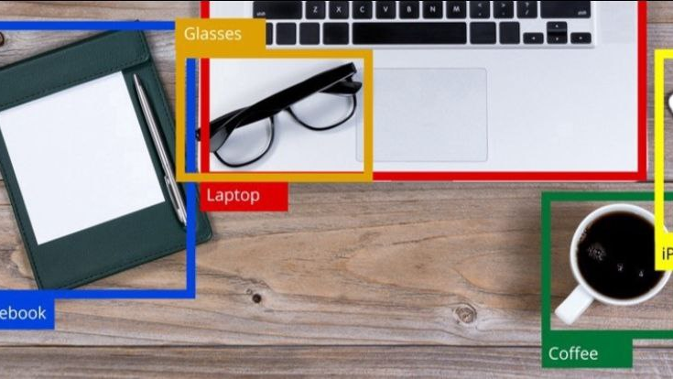
CONTEXT
In India every year nearly 4 to 5 lakh accidents happen .in those accidents almost 2 to 3 lakh people die.
Many of these accidents happen due to reasons like obstacles on the road and low visibility during night.
These minute human errors are making such huge losses to the society.

Slide 4
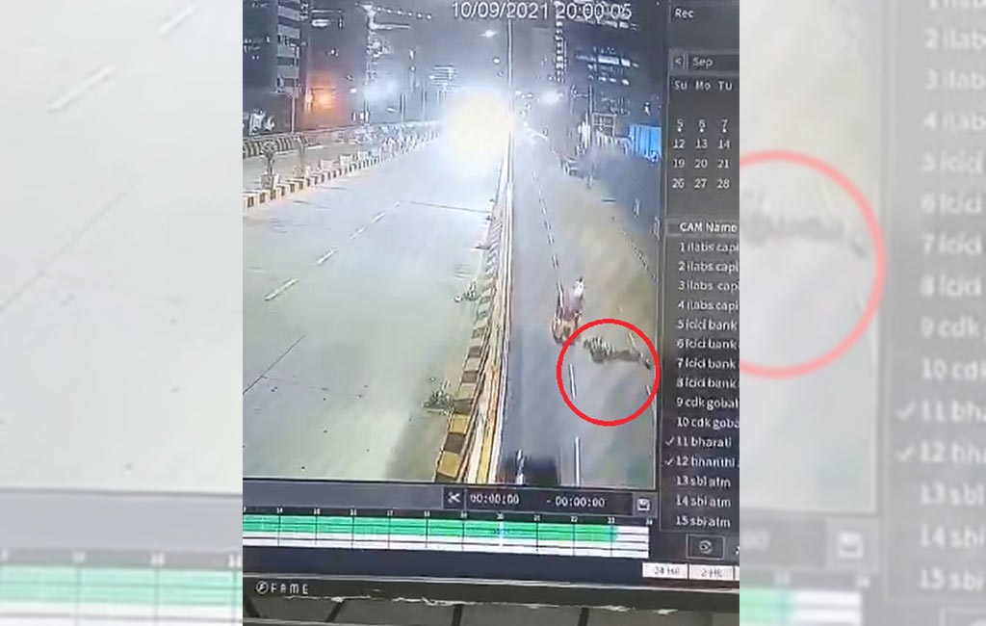
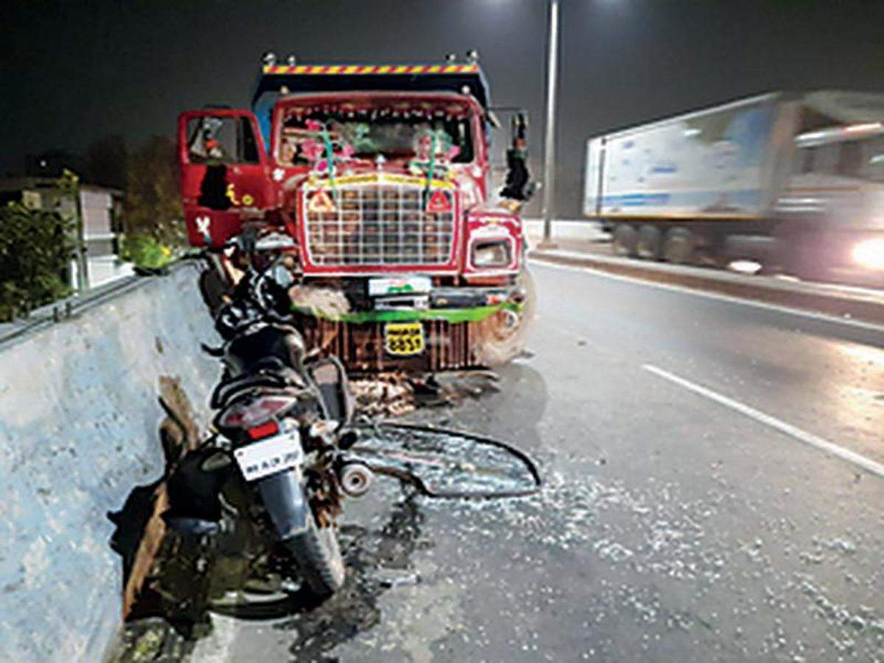

Slide 5
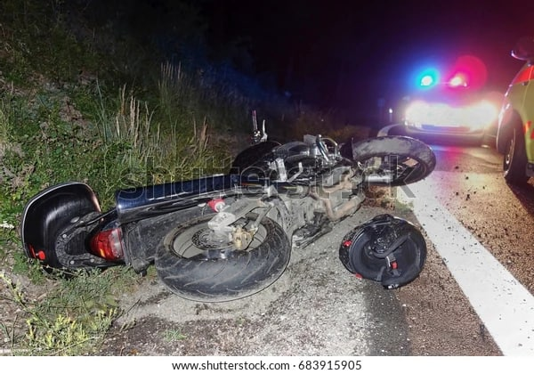
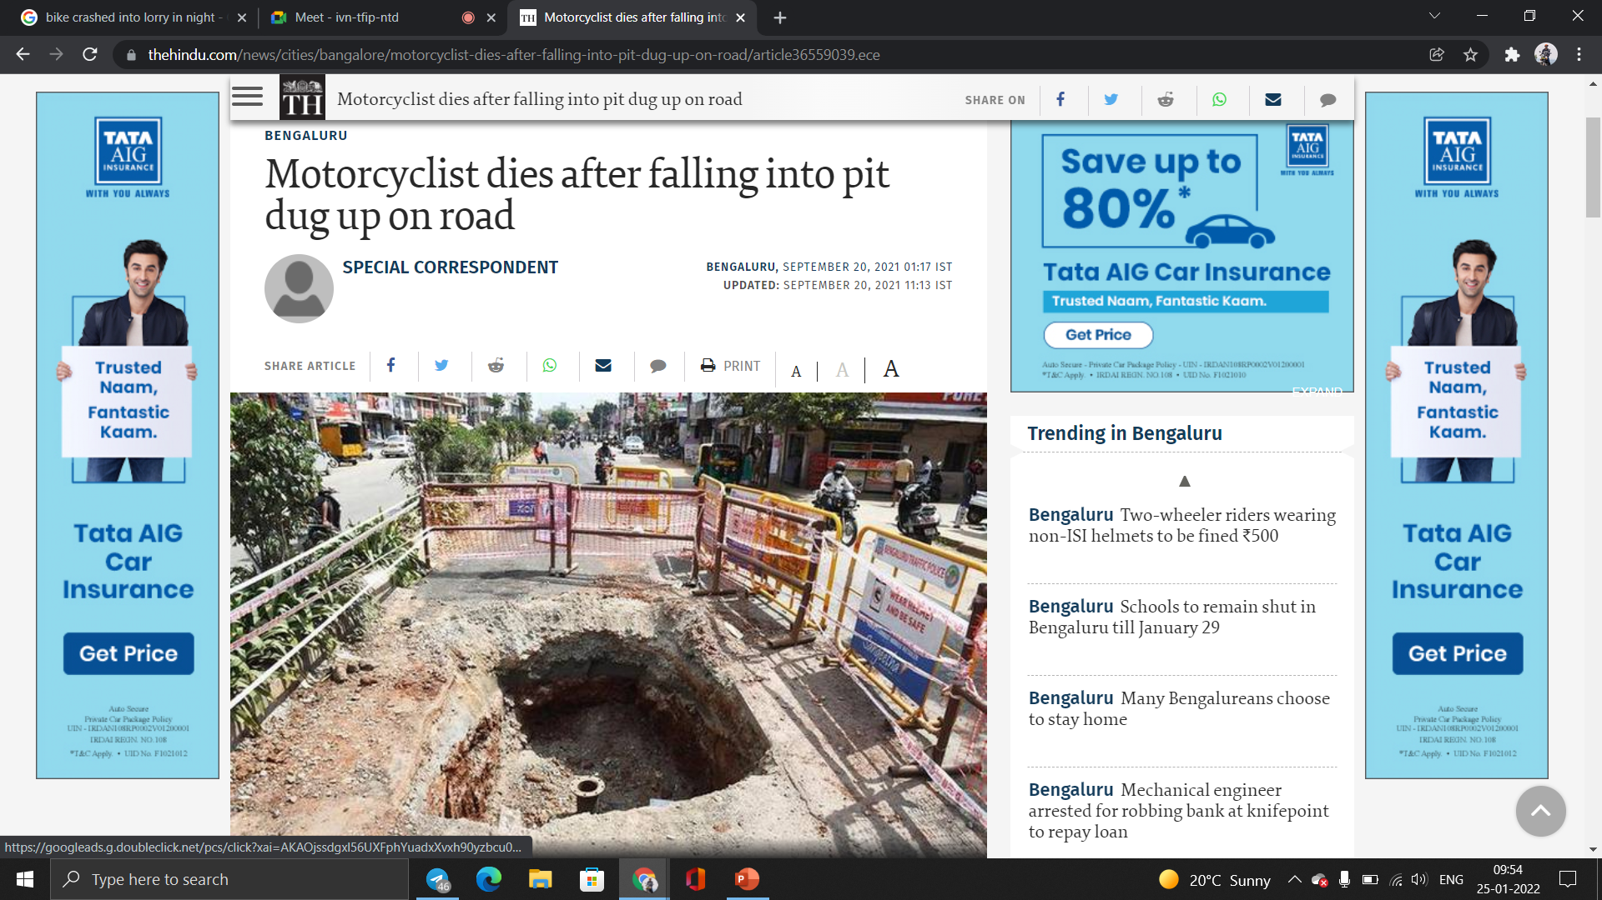

Slide 6
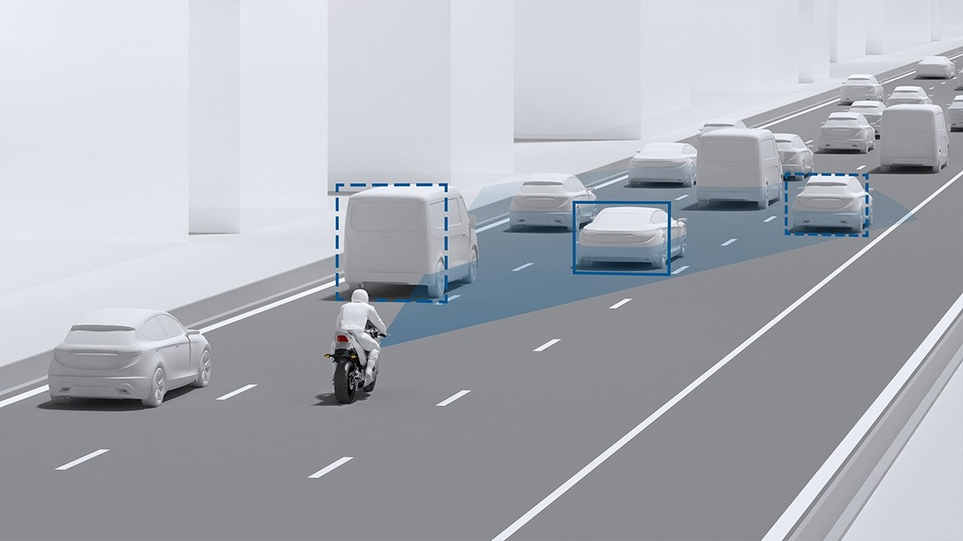
AI BASED TOOL TO ASSIST VEHICLES IN DETECTING OBJECTS TO AVOID ACCIDENTS

Slide 7
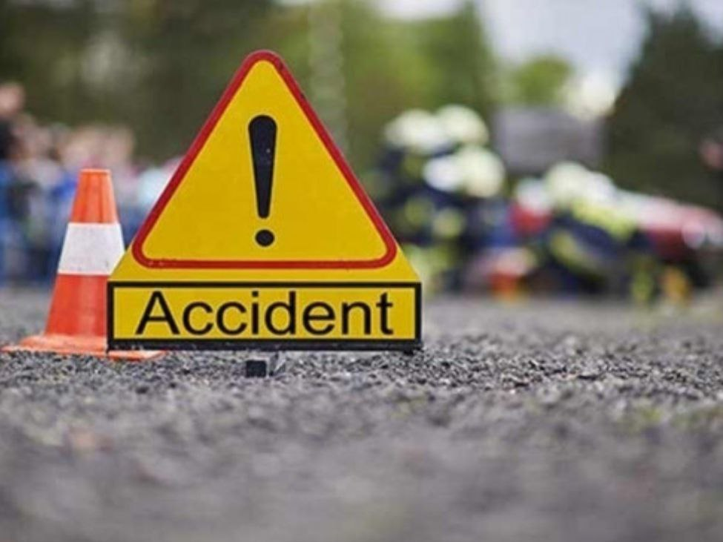
Problem statement
On a survey ABOUT TWO WHEELER ROAD ACCIDENTS , WE CAME TO KNOW THAT UPTO 60% OF ACCIDENTS HAPPEN AT NIGHT TIME.
MOST OF THESE ACCIDENTS were LEAD BY PITS ,SAND, ROCKS AND OTHER OBSTACLES ON THE ROAD.
DUE TO LOW VISIBILITY AT NIGHT TIME THESE OBSTACLES CAN’T BE SPOTTED BY THE RIDER.
THERE IS NO EXISTING TECHNOLOGY for alerting the rider in above scenarios .
SO WE WANTED TO EXPLORE THIS PROBLEM THROUGH OBJECT DETECTION.

Slide 8
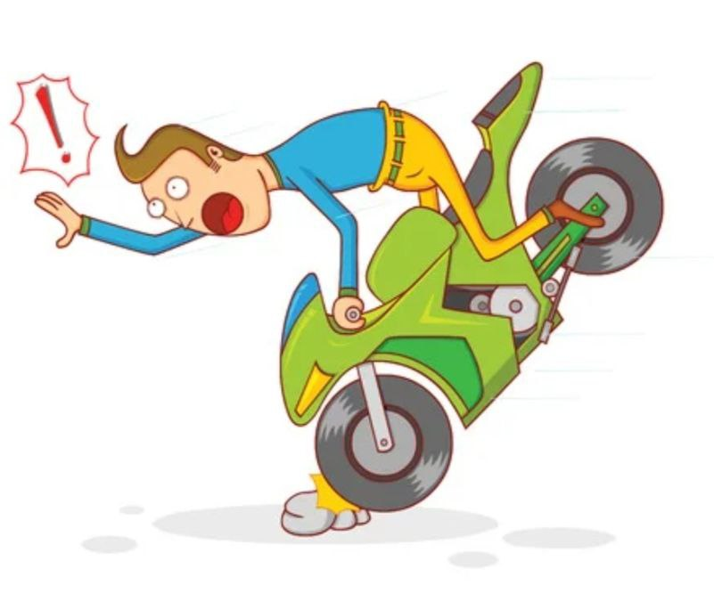
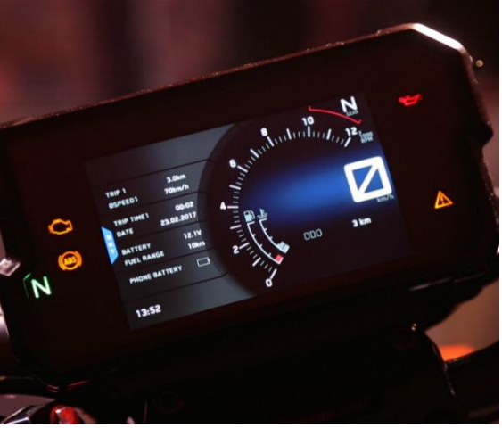
ABSTRACT :
The main purpose of this project is to build a object detector in vehicles to detect the obstacles(such as sand piles ,pits and rocks )
We want to indicate the obstacles by displaying obstacles on speed display meter
To convey the details of detected object in form of text message along with a voice command.

Slide 9
Literature Survey
S.NO | Author | Journal | Algorithm | Accuracy | Scope
1 | Zhongmin Liu Zhicai Chen Zhanming Li Wenjin Hu | Hindawi | YOLOv2, Y-PD, Faster R-CNN , Yolo v3, Non-maximum suppression algorithm | 90.9% | Because of the diversity of size, resolution and so on, there is still a big gap between our model and the state-of-art pedestrian methods. So future task will mainly work on designing of the better model of the Caltech dataset for pedestrians.
2 | Shrinath Oza , Dr. Sunil Rathod | International Journal of Engineering Research & Technology (IJERT) | Haar Cascade algorithm Viola jones algorithm YOLO Algorithm DCNN Algorithm CNN Algorithm | 80% | The main purpose of the system is to implement the real-time objects detection system on a Raspberry Pi to avoid accidents and improving road safety.
3 | Mukesh Tiwari, Dr. Rakesh Singhai | International Journal of Computational Intelligence Research | SURF (Speeded Up Robust Features)algorithm | 89% | Need to focus towards enhancing the variance data of each channel based on the Mahalanobis distance calculation. By this, can able to adopt a change in the rapid scene through Euclidean distance algorithm.

Slide 10


OUR APPROACH TO THE PROJECT

Slide 11
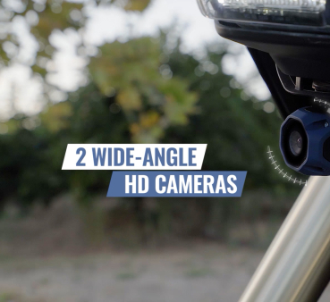
STEP 1-INPUT
THE INPUT IS CAPTIVATED FROM A CAMERA FIXED TO THE BIKE HEADLIGHT.
THE CAMERA USED WILL BE A 4k resolution WIDE ANGLED CAMERA FOR BETTER RESULTS.

Slide 12
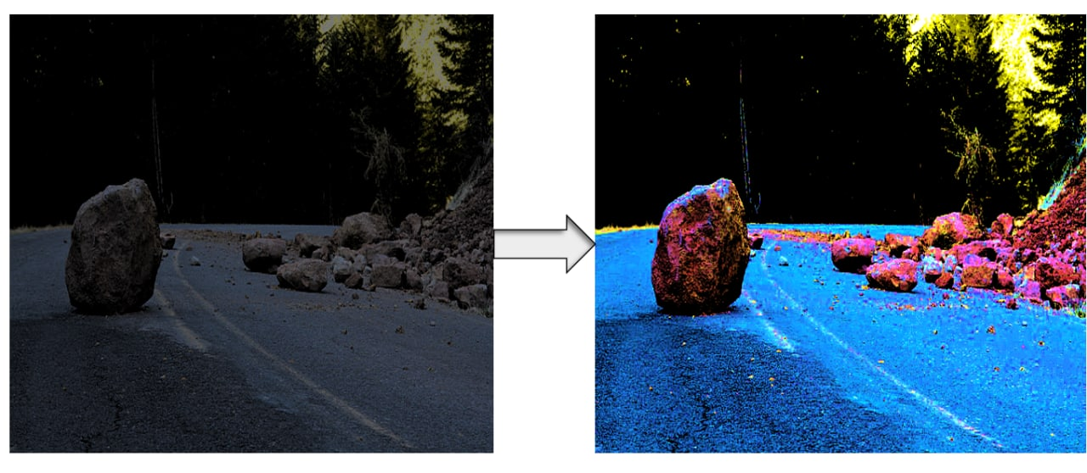
STEP 2- IMAGE ENHANCEMENT
THE IMAGE will be RECEIVED BY THE Arduino Attached TO THE CAMERA.
As the pictures are taken at night time, to enhance the clarity some changes are made . (increasing brightness , contrast, adjusting saturation)
For this enhancement we will be using retinex algorithm.

Slide 13
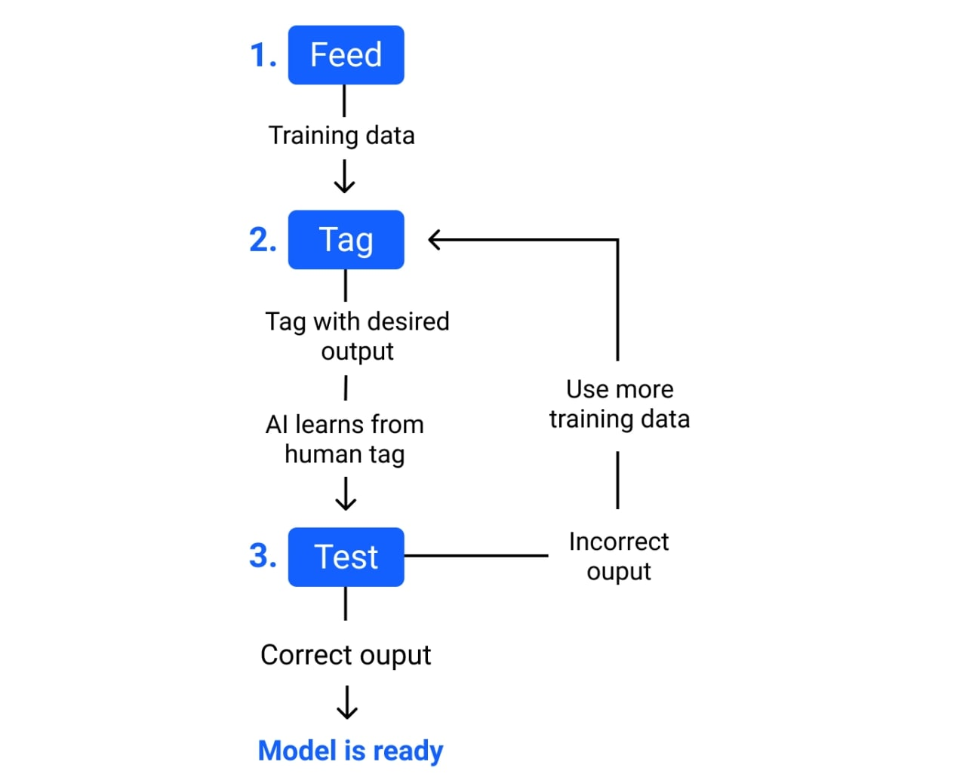
Step 3-Dataset training
Here we will be training our software by providing proper datasets.
1. Feed- to input data for training a machine learning model .
2. Tag- name the training data with a desired output. The model transforms the training data into text and vectors – numbers that represent data features.
3. Test-test the model using new inputs .if it gives correct output the model is ready. If not train the model with few more datasets.

Slide 14
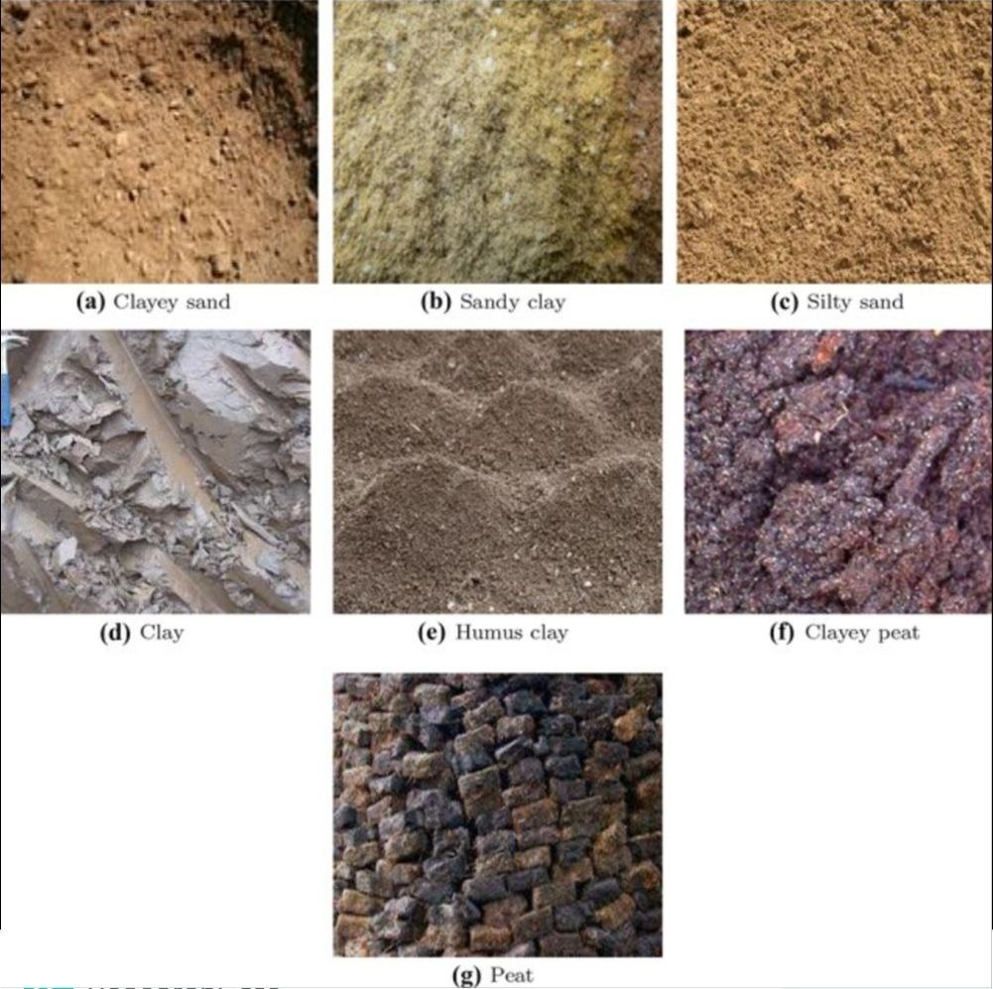
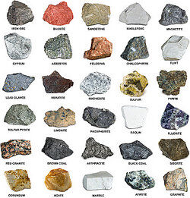
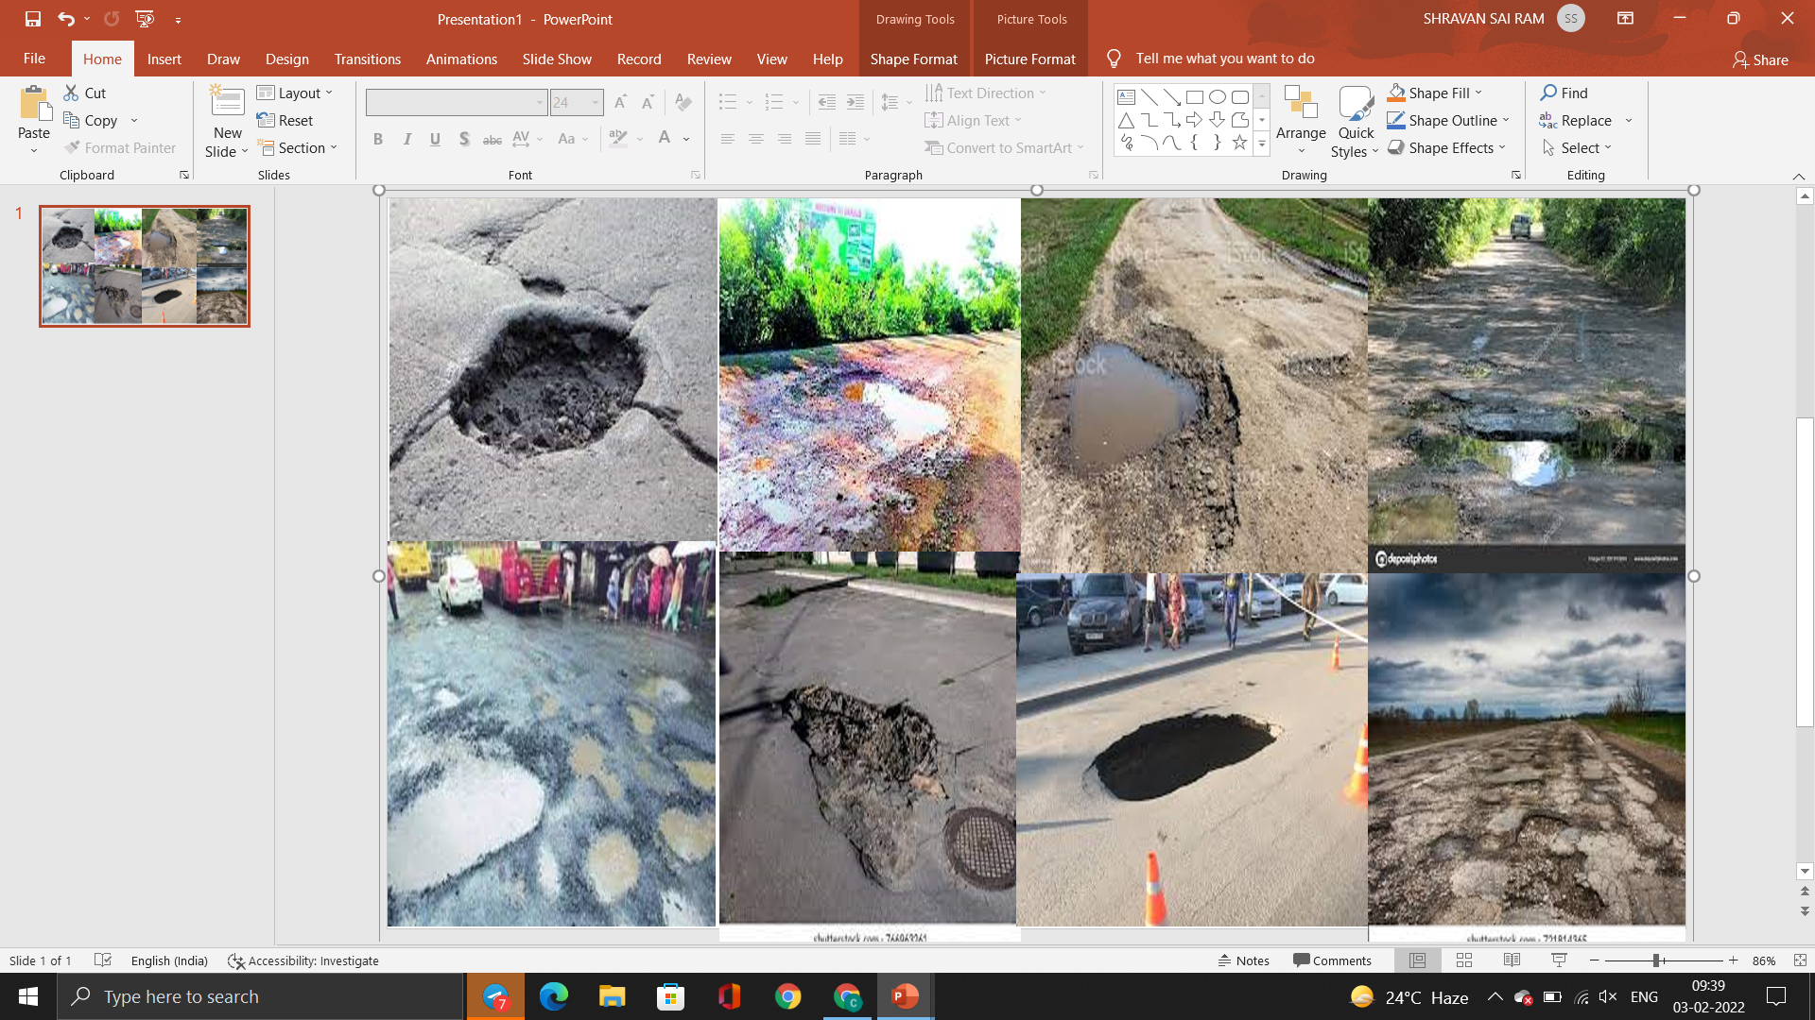
Images of few datasets

Slide 15
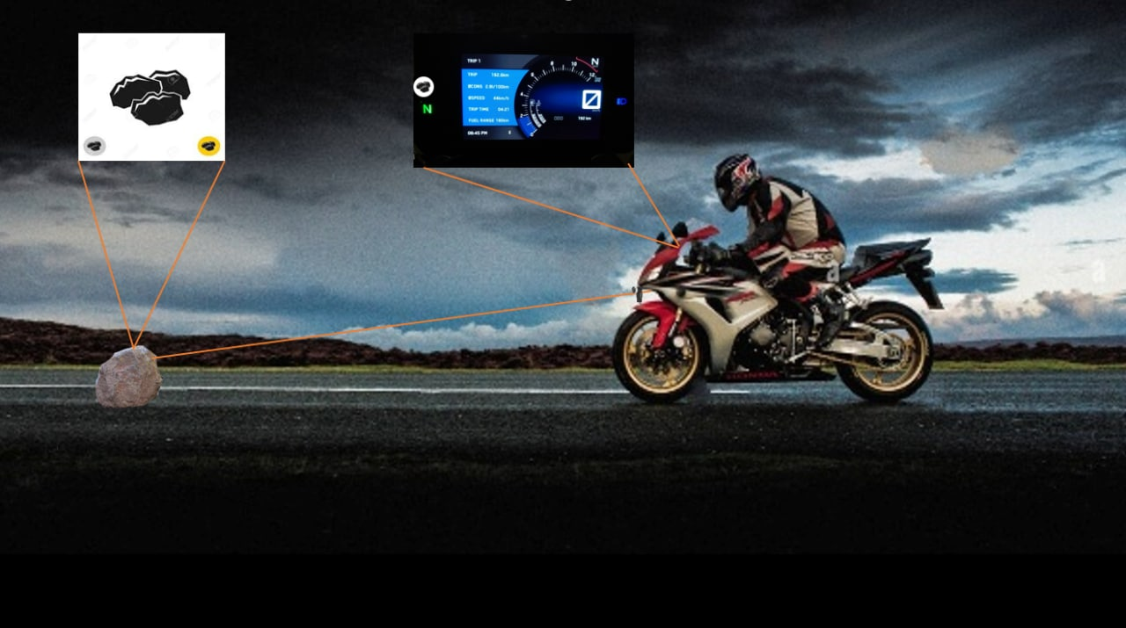
STEP-4 IDENTIFICATION AND DETECTION
THE PROCESSED IMAGE will be IDENTIFIED ACCORDING TO ITS DATASET (SAND, ROCKS AND PITS).
For image identification and detection we will be using yolov3 algorithm.
We will be using OpenCV , keras and TensorFlow libraries for this step.
AS THE IMAGE IS IDENTIFIED THE INSTRUCTION will be GIVEN TO proceed with the output .

Slide 16
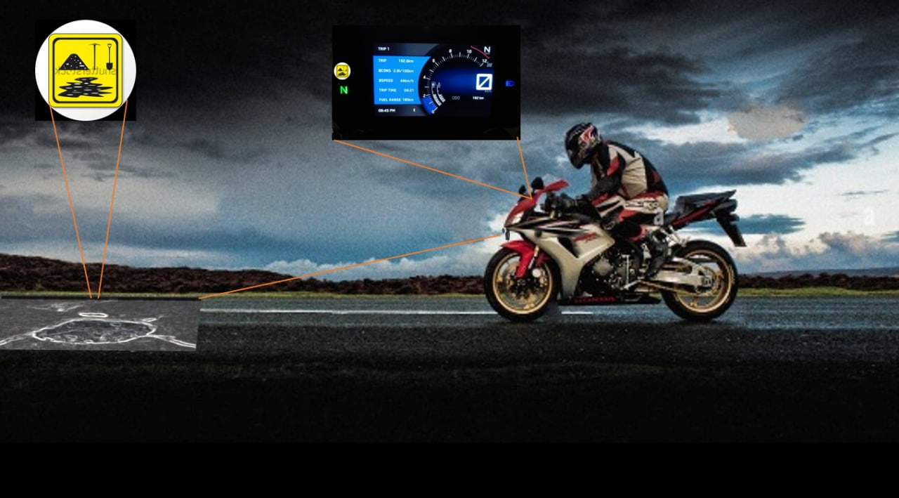
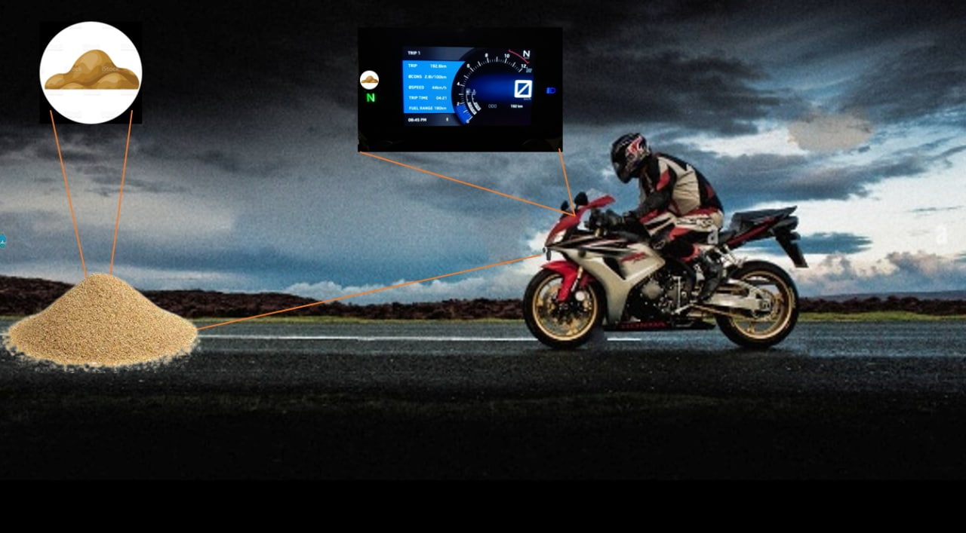

Slide 17
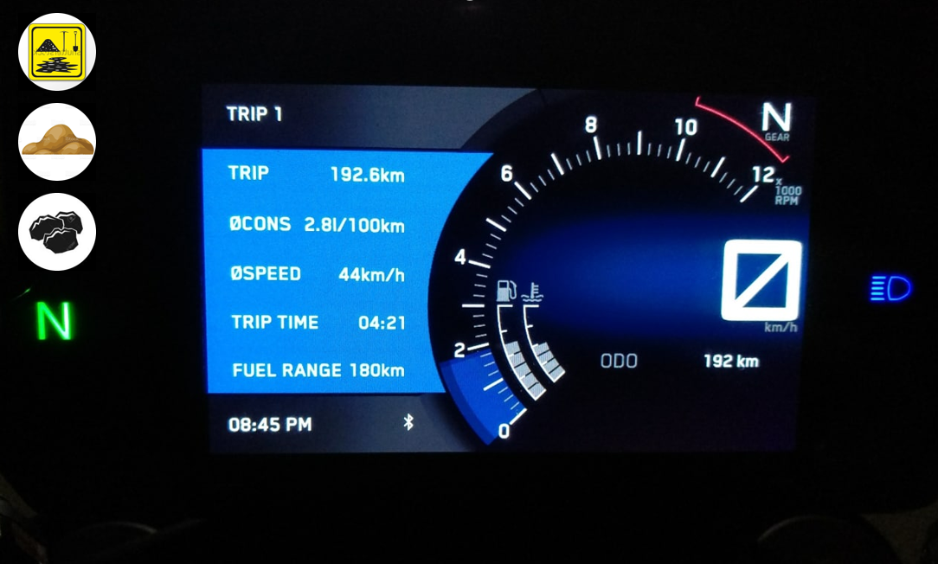
STEP-5 OUTPUT
THE OUTPUT will be IN THE FORM OF PICTURE and an VOICE COMMAND.
THE PICTURE will be DISPLAYED ON THE digital SPEEDOMETER.
The voice command will be passed on to the rider’s helmet via Bluetooth.

Slide 18
Flowchart of object detection

Slide 19
Capturing Images
IMAGE ENCHANCEMENT
Feeding images
Dataset loading
If fails
Dividing picture into blocks
DATASET TRAINING
Manual screening
Picture identification
IDENTIFICATION
AND DETECTION OF DATASETS
If passed
Display symbol/voice command
Final dataset
Dataset comparsion

Slide 20
METHODOLOGY
Data
Pre-processing
Feature engineering
Model Creation
Backend Creation
API Implementation
Model Testing

Slide 21
Tools and packages
Tools
Py-charm
Flask
Packages
Open-cv
TensorFlow
Pandas
NumPy

Slide 22
CONCLUSION
By choosing this topic, we have aimed to produce optimized solution for the obstacles that have come up in the experiments we have seen till date.
Our product will be useful in road condition monitoring and prevent accidents during night time .
Our attempt here is to try to develop a better solution for object detection in vehicles .
In addition to that we are also attempting to convey the info of detected objects to the rider in an efficient manner.

Slide 23


